Slide 1
A Reproduction Study
Kinematic-Wave-Based Adaptive Transit Signal Priority Control using Genetic Algorithm
Original paper: Behbahani, H. & Poorjafari, V. (2022). IET Intelligent Transport Systems, 17(5), 912-928.
DOI: 10.1049/itr2.12316
Notes:
Reproduction study of the KATC controller: reimplement from scratch, evaluate honestly what reproduces and what does not.

Slide 2
Background & Problem Statement
2
Transit Signal Priority (TSP) gives public-transport vehicles priority at signalised intersections, ideally without unduly penalising general traffic.
Conventional signal control
KATC's passenger-based approach
Optimises for vehicles — every car counts equally. A full bus carrying 40+ passengers is weighted the same as a single-occupant car.
Optimises for passengers — vehicles are weighted by occupancy. A full bus receives priority proportional to the people it carries.
Problem: minimise average passenger delay across both modes at a signalised intersection.
Notes:
Conventional control counts vehicles; KATC counts people. The objective is average passenger delay across both modes.

Slide 3
Summary of the Paper's Method (KATC)
3
A closed control loop, re-optimising the signal each cycle over a three-cycle decision horizon:
I.
Read — traffic state, and PT-vehicle position and passenger occupancy (via V2I)
Objective (Eq. 43)
minimise average passenger delay
II.
Model — predict delay for any candidate plan using kinematic-wave shockwave analysis
III.
Optimise — a genetic algorithm searches green-time splits and phase sequence
= total passenger-seconds of delay ÷ passengers served
IV.
Actuate — deploy the best plan, advance one cycle, and repeat
Notes:
Four-element loop: read, model, optimise, actuate. Updated every cycle over a 3-cycle horizon. Objective is Eq 43.

Slide 4
Performance, Results & Conclusions (Paper)
4
Three controllers compared across 35 scenarios (7 saturation levels × 5 occupancy levels), 10 runs each:
Controller
Optimises
Outcome
KATC-2
green times + phase sequence
lowest passenger delay (best)
KATC-1
green times only
intermediate
SYNCHRO
vehicle-based baseline
highest delay
Key finding. KATC-2 reduces passenger delay versus both baselines, with the largest improvements at low saturation and high PT occupancy.
Notes:
Paper: KATC-2 best, KATC-1 middle, SYNCHRO worst. Gains largest at low DOS, high occupancy. This is the pattern our reproduction inverts at low DOS.

Slide 5
Information-Systems Methods Implemented
5
1.
Genetic Algorithm — the primary optimiser — searches the signal-plan space (a MINLP)
2.
Metaheuristic search operators — elitism, tournament selection, mask crossover, adaptive mutation
3.
Epsilon-greedy (multi-armed bandit) — selects phase sequence from simulation-measured bus delay
4.
Kinematic-wave modelling — analytical delay surrogate serving as the GA's fitness function
5.
Constraint handling — guarantees feasible signal plans (cycle length, minimum green, dual-ring barrier)
6.
Discrete-event simulation — SUMO software-in-the-loop evaluation of the controller
Notes:
Six classical IS methods; GA primary, others supporting. Epsilon-greedy is a bandit heuristic, NOT reinforcement learning.

Slide 6
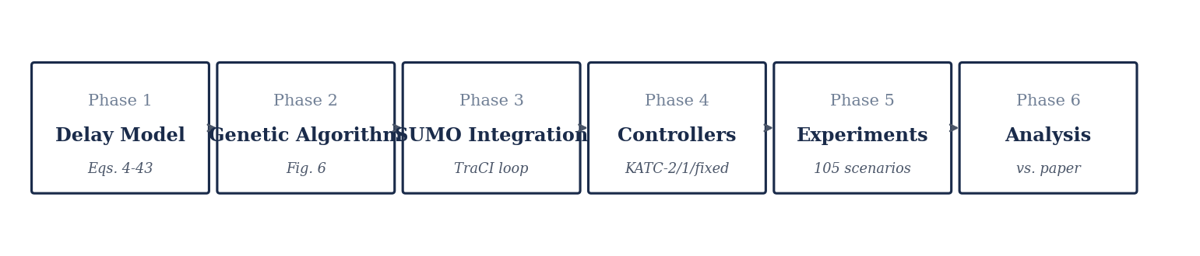
Reproduction Architecture
6
The method was rebuilt as six phases; Phases 1-2 form a simulator-independent analytical core, Phases 3-6 the simulation and evaluation.
Phases 1-2 validated by 37 unit tests; Phases 3-6 validated in simulation. Each phase maps to a section of the paper.
Notes:
Six phases. 1-2 analytical core (pure Python). 3-6 simulation and evaluation. Each maps to a paper section.

Slide 7
Phase 1 — Kinematic-Wave Delay Model
7
The analytical engine that predicts delay for any signal plan — the fitness function the GA optimises.
Component
What it computes
Reference
Fundamental diagram
triangular flow-density relation → shockwave speeds
Eqs. 2-3
General-traffic delay
queue formation, dissipation, residual carry-over across cycles
Eqs. 4-12
PT-vehicle delay
four cases × sub-cases by bus position and saturation state
Eqs. 13-42
Average passenger delay
combine both modes; weight PT by occupancy
Eq. 43
Validation. 22 unit tests confirm physical sanity and an internal identity — the oversaturated queue equation (Eq. 11) reduces exactly to the undersaturated one (Eq. 4) when residuals vanish, evidencing faithful transcription.
Notes:
Kinematic-wave delay model. No worked example in the paper, so validated by physical sanity + internal identity (Eq 11 -> Eq 4).

Slide 8
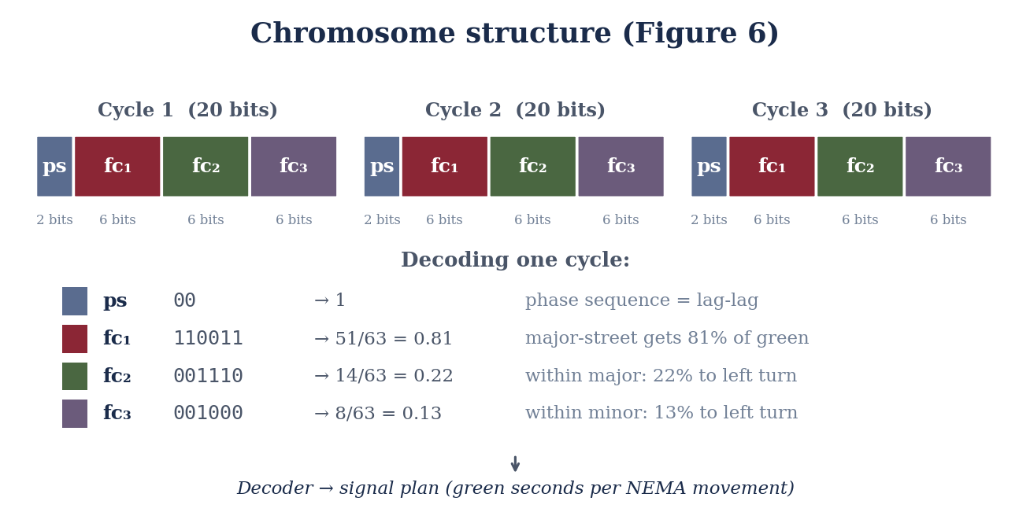
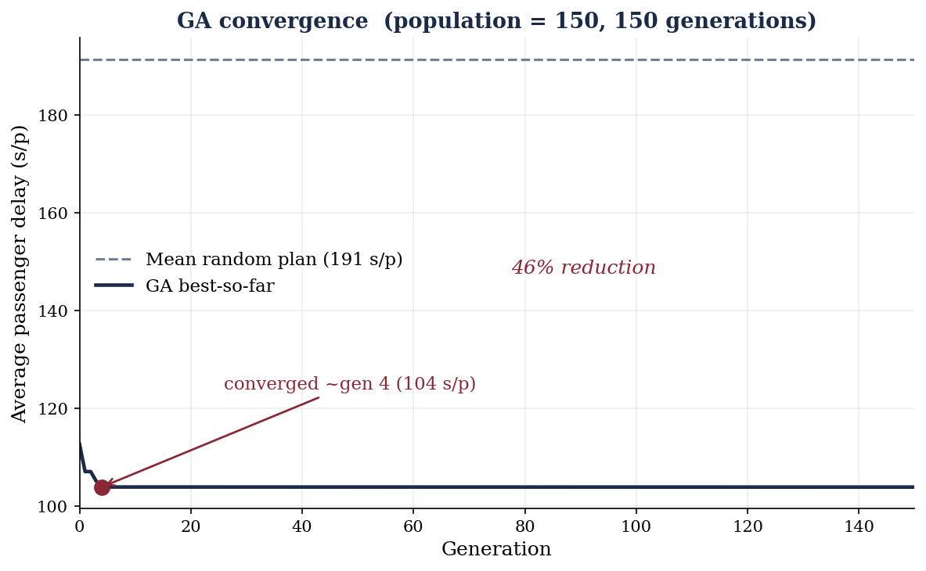
Phase 2 — The Genetic Algorithm
8
Why a genetic algorithm. The problem is mixed-integer and non-linear — a discrete phase sequence and a non-smooth delay function. Gradient methods require smoothness; the GA needs only to score candidates.
Configuration (verified). Population 150 · 150 generations · elitism · mask crossover · adaptive mutation 0.01→0.02 · fitness = 1 / average passenger delay.
Result. ≈46% delay reduction versus random plans; convergence in ≈25 generations (<3 s) — consistent with the paper.
Notes:
Star slide. Chromosome = 60-bit string (2-bit phase sequence + three 6-bit green-split factors per cycle x 3 cycles). GA evolves toward low delay. NOT reinforcement learning.

Slide 9
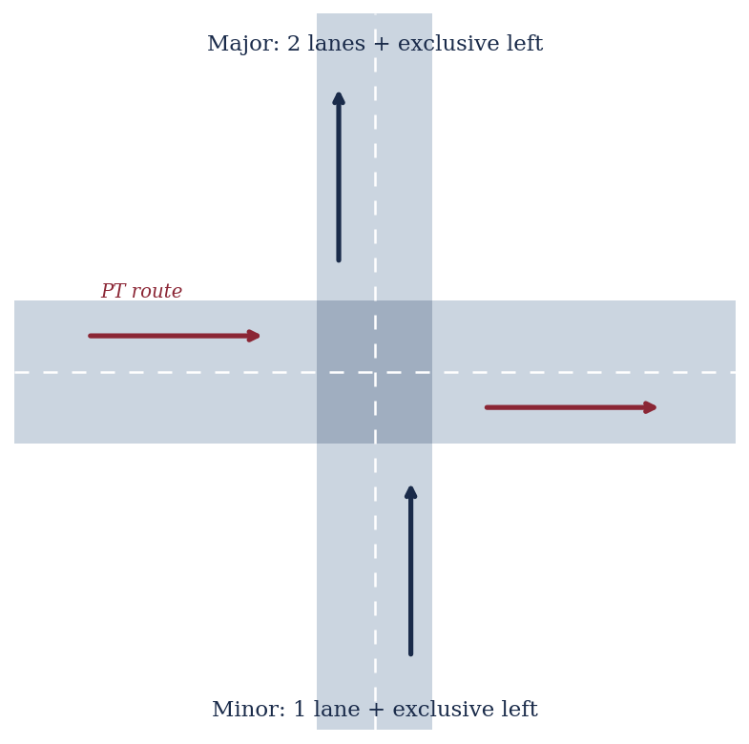
Phase 3 — Simulation (SUMO)
9
Closed control loop over TraCI, replacing the paper's VISSIM + COM interface:
1.
Read — queue state, bus position and occupancy
2.
Optimise — run the KATC controller (Phases 1-2)
3.
Actuate — write the NEMA signal plan back to SUMO
4.
Step — advance one cycle, then repeat
Full NEMA dual-ring signal (eight movements, exclusive left lanes, lead/lag ordering) was chosen so the phase-sequence variable — KATC-2's contribution — is meaningful in simulation.
Notes:
Phase 3 embeds the controller in SUMO (substituting VISSIM). Fig 7 intersection, 8 bus routes, read-optimise-actuate loop over TraCI. Full NEMA dual-ring.

Slide 10
Reproducibility Challenges
10
Details the original left unspecified, and the principled reconstructions made (each documented):
VISSIM → SUMO
commercial simulator (trial disables the control interface) replaced by open-source SUMO + TraCI
SYNCHRO → Webster
commercial baseline replaced by a fixed-time Webster plan
Intersection geometry
Fig. 7 under-specified; exclusive-left-lane structure reconstructed, an error caught by inspecting the simulation
Coefficient-factor mapping
the three-factor to eight-movement mapping is unpublished; a dual-ring interpretation was adopted
Phase sequence in the model
the analytical delay is sequence-invariant; phase sequence was instead measured from live simulation
Notes:
These are the findings of a reproduction study — the paper's terse spec forced documented choices.

Slide 11
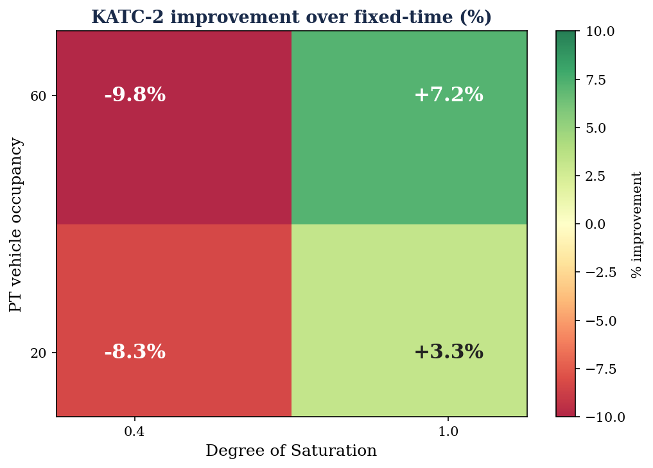
Reproduction Results — Key Finding
11
KATC-2 was partially reproduced:
At high saturation KATC-2 outperforms fixed-time (+5 to +11%), matching the paper's direction.
At low saturation KATC-2 underperforms fixed-time — the opposite of the paper's reported pattern.
Likely causes. re-optimisation instability at low demand; the analytical fitness diverging from simulated delay; uncalibrated fundamental-diagram parameters.
Notes:
Central finding: reproduces at high DOS, inverts at low DOS. Honest analysis of why is the intellectual payoff.

Slide 12
Conclusion
12
Reproduced
the full method — the delay model, the GA optimiser (converging as reported), and the closed simulation loop.
Diverged
KATC-2 outperformed fixed-time at high saturation but not at low — the reverse of the original.
Learned
the value of a reproduction lies in understanding where and why a method holds or breaks, not in matching every figure.
Notes:
Three takeaways: reproduced the method, diverged at low DOS, and the lesson is understanding why. Close confidently.

